Slide 1
SURF 2024 - 2nd Meeting
Ryan Hsieh 2024/05/30

Slide 2
AGENDA
Research Paper Read (IEEE)
Data Analysis
Actual Python Solution

Slide 3
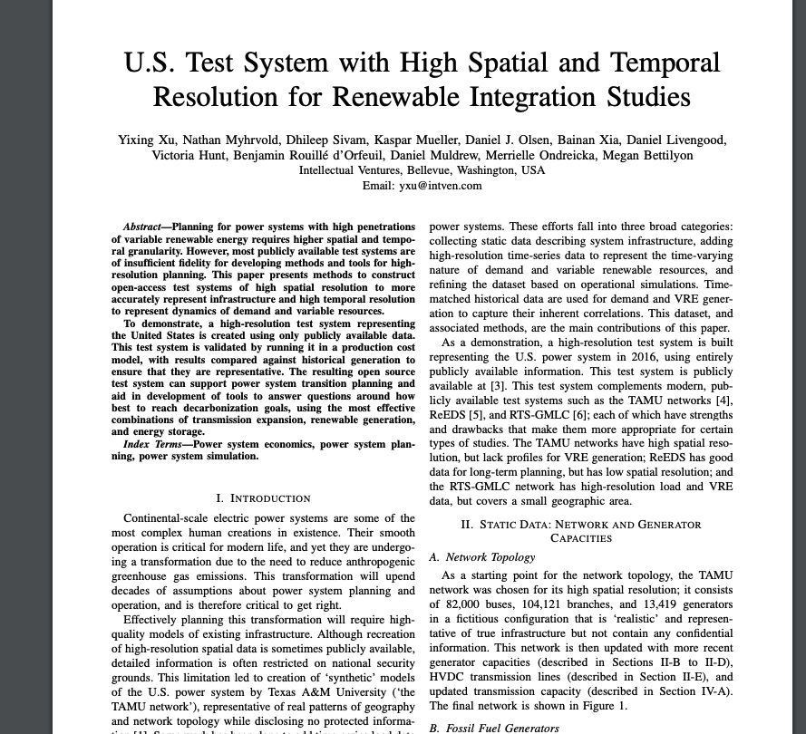
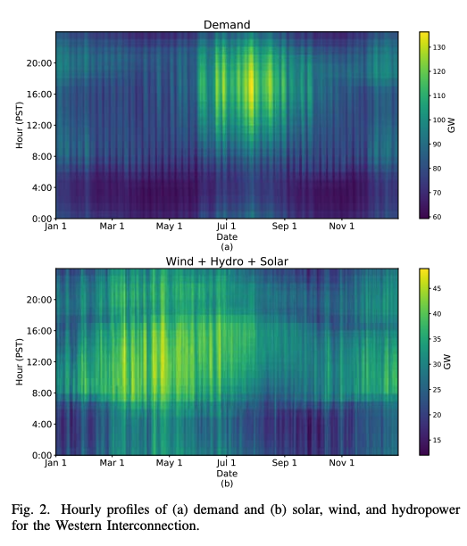
IEEE paper
Sample Paper uses data@zenodo from Breakthrough Energy
Utilizing tools (REISE.jl & Julia) produce heatmaps from the data

Slide 4
Data Analysis & File translating - Directly from Data folder

Slide 5
Part 1: Data for user demand
Demand Power Data in the US

Slide 6
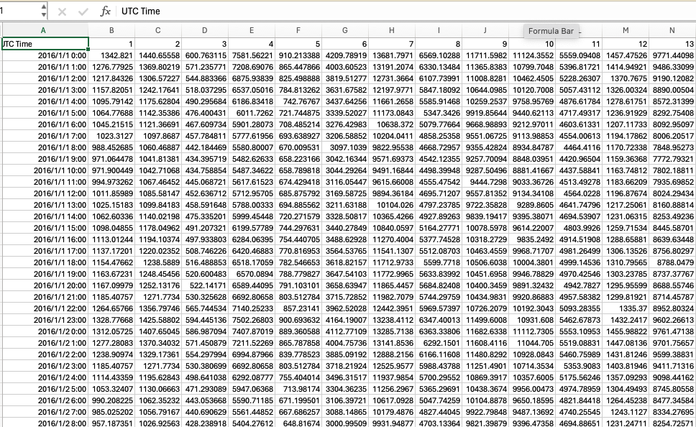
Raw Demand Data
Can : Figure out it's a time-series values of demand over the year
Can't : Figure out the unit of the values and what each number in the first row represent

Slide 7
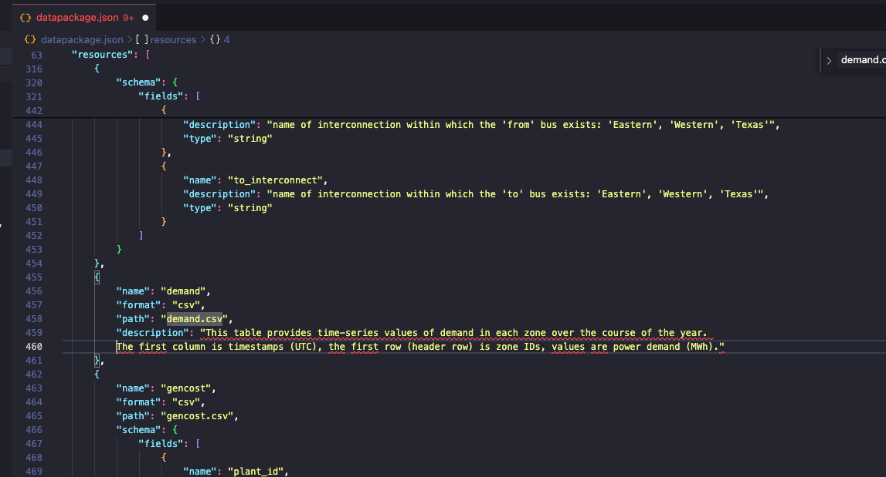
Data Analysis

Slide 8
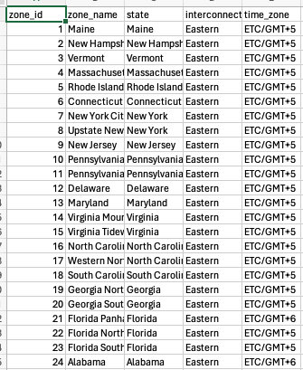
Data Analysis
After figured out the first row represent IDs of each zone
In base_grid folder, use the file called zone.csv to understand the detailed information of that certain zone ID
Each zone maps to its zone name, state, interconnect, time zone

Slide 9
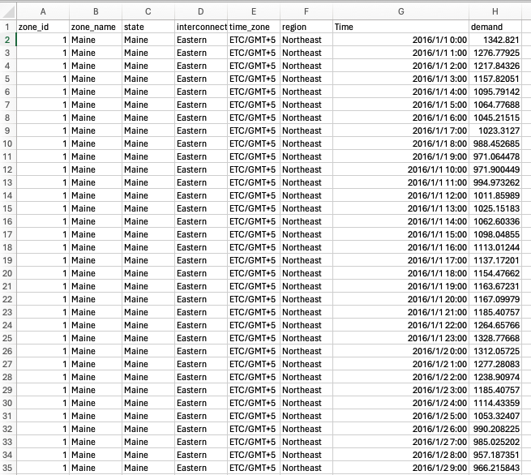
File Translating
Goal: Using the zone information file to enrich the demand data file
Define dictionary in Python for the four regions in United States, and categorize states in each region
Re-organize demand data from x-axis to y-axis, so that each zone can have their information on the left and demand data extending downwards (daily for whole year)
Original csv file data extend to right direction won't be efficient for future use

Slide 10
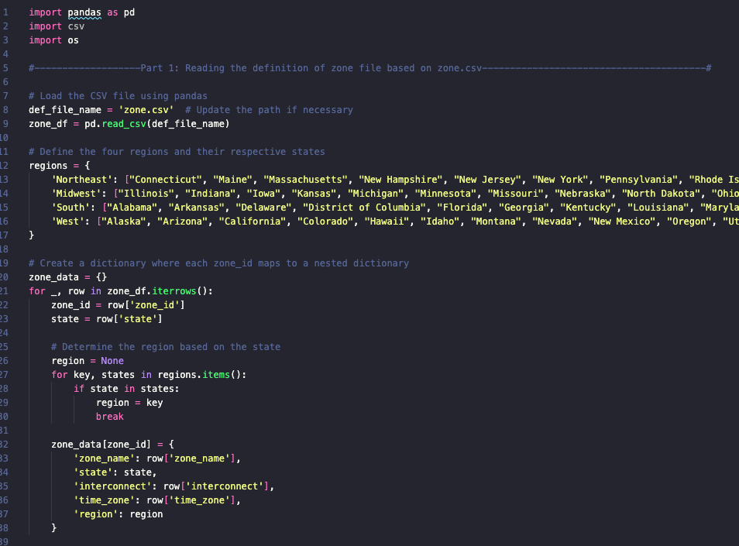
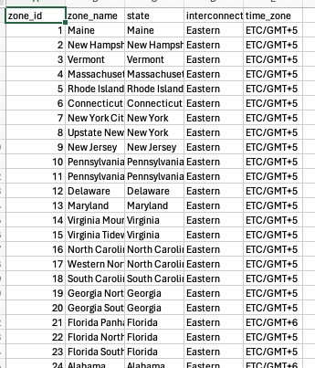
File transition solution

Slide 11
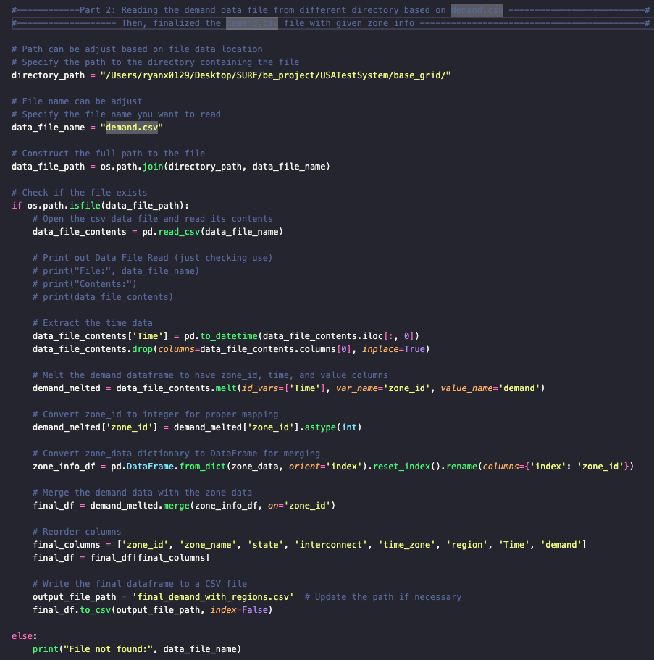
FILE TRANSITION SOLUTION
Read demand data file & use nested dictionary formed earlier to re-organize the csv data file

Slide 12
Part 2: Data for Substation Power Generator
Substation Power Generator Location in the US

Slide 13
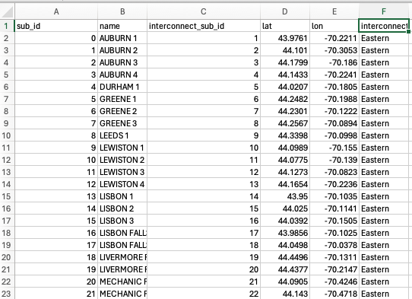
Raw sub data
SUB means the substation, is a part of an electrical generation, transmission, and distribution system.
transform voltage from high to low, or the reverse
Can't : Figure out the state & region of certain substation
Can : Use the latitude/longitude to know the exact location

Slide 14
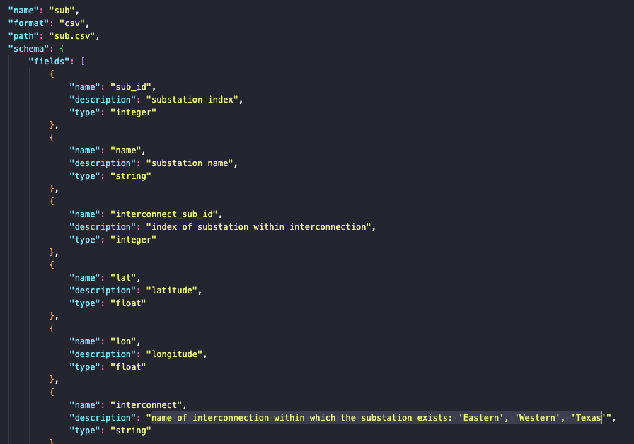
Data Analysis

Slide 15
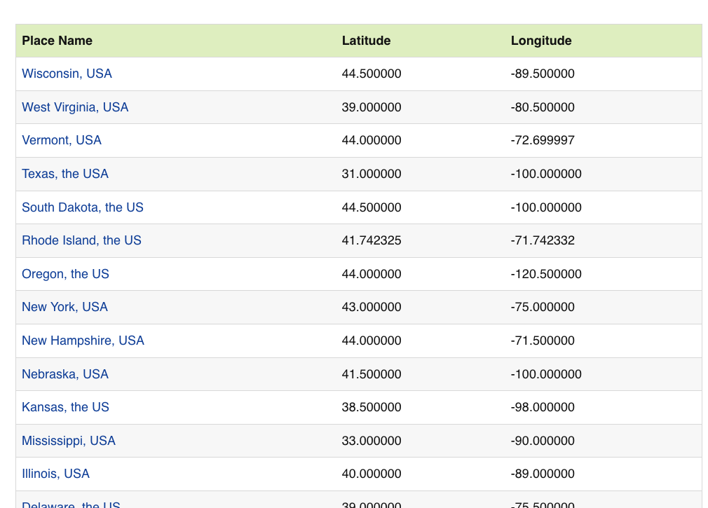
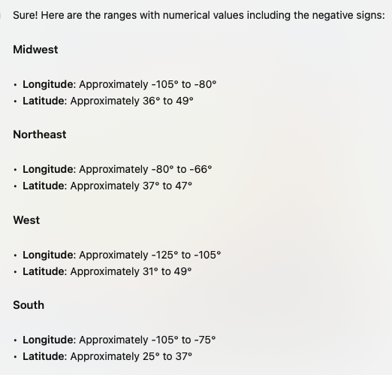
Data Analysis

Slide 16
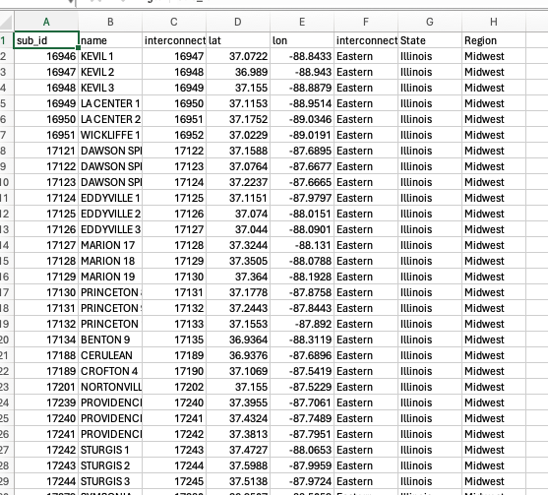
File Translating
Goal: Determine all the substation's exact state & region using longitude/latitude
Define dictionary in Python for the four regions in United States, and categorize states in each region by lon/lat
Re-organize sub data in order of regions/states, also add on 2 columns for regions/states

Slide 17
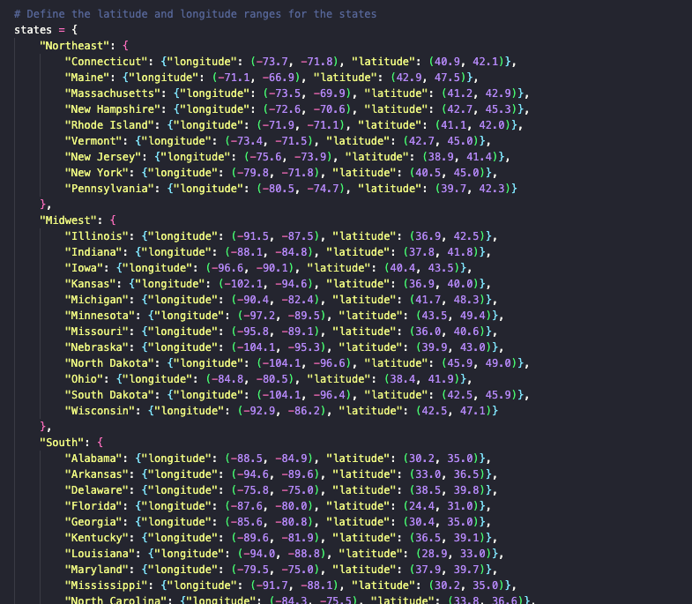
FILE TRANSITION SOLUTION
After researching for the longitude/latitude range for each state and the regions
Form them into nested dictionary for further use of identifying data

Slide 18
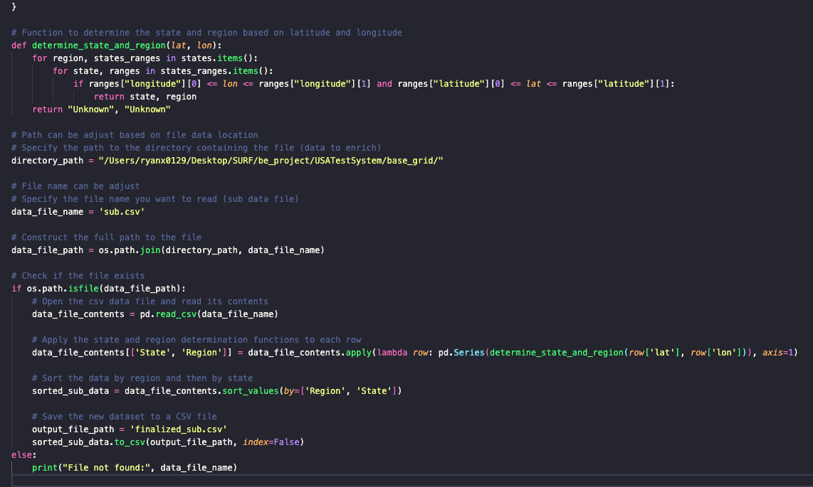
FILE TRANSITION SOLUTION

Slide 19
Part 3: Data for 3 types of power generated
Hydro, Solar, and Wind Power Generated Data

Slide 20
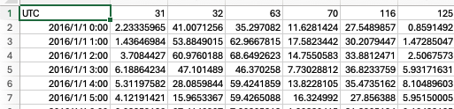
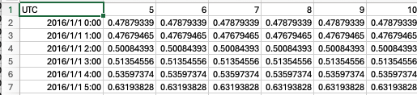
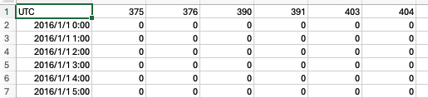
Raw power data
Same as demand data : time-series values of power generated over the year (wind, hydro, solar)
Can't : Figure out the unit of the values and what each number in the first row represent
Raw Wind Data
Raw Hydro Data
Raw Solar Data

Slide 21
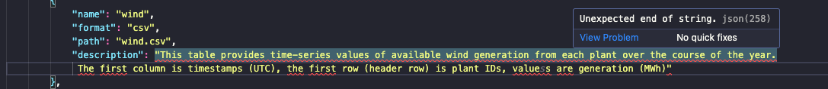
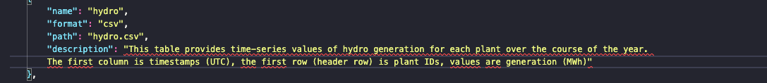
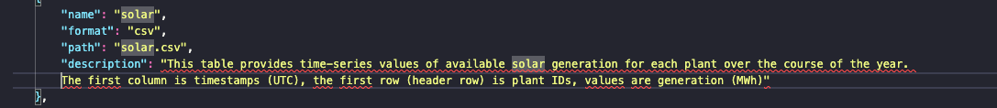
Data Analysis

Slide 22
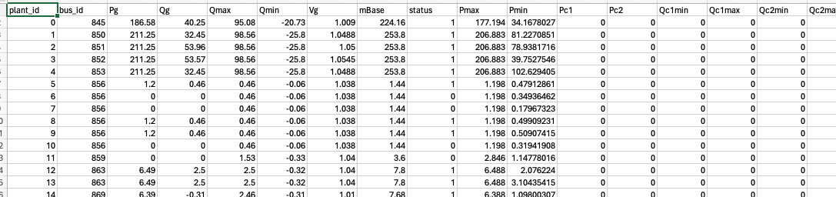
Data Analysis
After figured out the first row represent IDs of each plant generator
In base_grid folder, use the file called plant.csv to understand the detailed information of that certain plant ID
Each plant ID map to its detailed info (real power output (MW), maximum reactive power output etc.) ==> Focus only on plant_id and its mapped bus_id
What's bus_id?

Slide 23
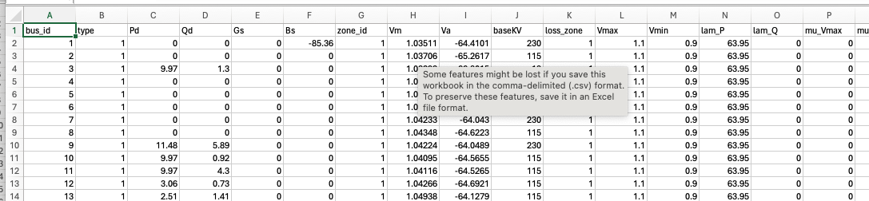
Data Analysis
Bus? Node on the line where the loads and generator connects in power system
Help to determine the location of the power plant
In base_grid folder, use the file called bus.csv to understand the detailed information of that certain bus ID
Each bus_id map to its own detailed info (bus type, real power demand (MW) etc.) ==> Focus only on zone_id
Lead back to earlier use of zone.csv to figure the location of this power plant

Slide 24
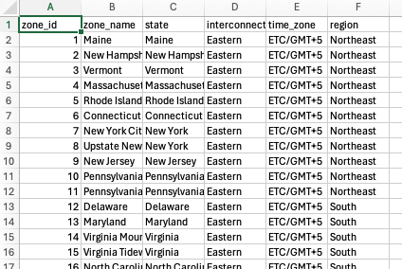
DATA ANALYSIS
The demand file transition solution program utilize the raw zone.csv file (Without region)
The python script can also generate an improved version of zone.csv file with region, easy to determine Midwest region
Utilizing this generated zone_with_region.csv file, it can help to map the earlier unknown location zone_id, in order to find the location of that zone_id

Slide 25
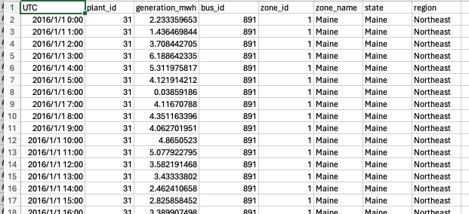
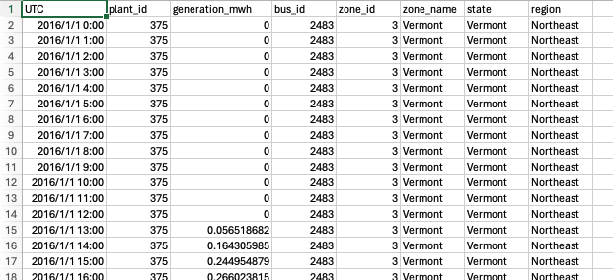
File Translating
Goal: Using the plant and bus information file with exact location to enrich the power data file (Same for hydro, wind, solar)
Read plant.csv, bus.csv, and zone_with_regions.csv file to create dictionary based on the info need
Original time series of power value data lack of exact location, states, regions, and power plant location
Re-organize demand data from x-axis to y-axis, so that each plant ID can have their information on the left and power generated data extending downwards (daily for whole year)
Original csv file data extend to right direction won't be efficient for future use
Enriched Version Wind Power Data
Enriched Version Solar Power Data

Slide 26
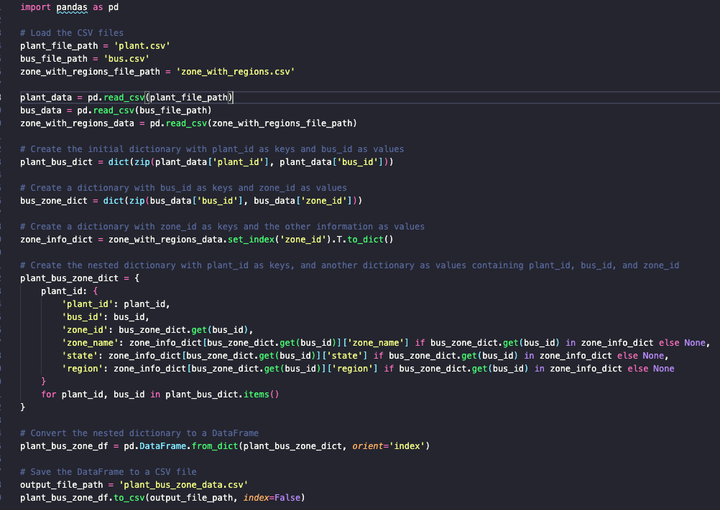
FILE TRANSITION SOLUTION
Read three files: plant, bus, zone_with_regions
Create nested dictionary for futher use including:
Plant_id
Bus_id
Zone_id
Zone_name
State
Region

Slide 27
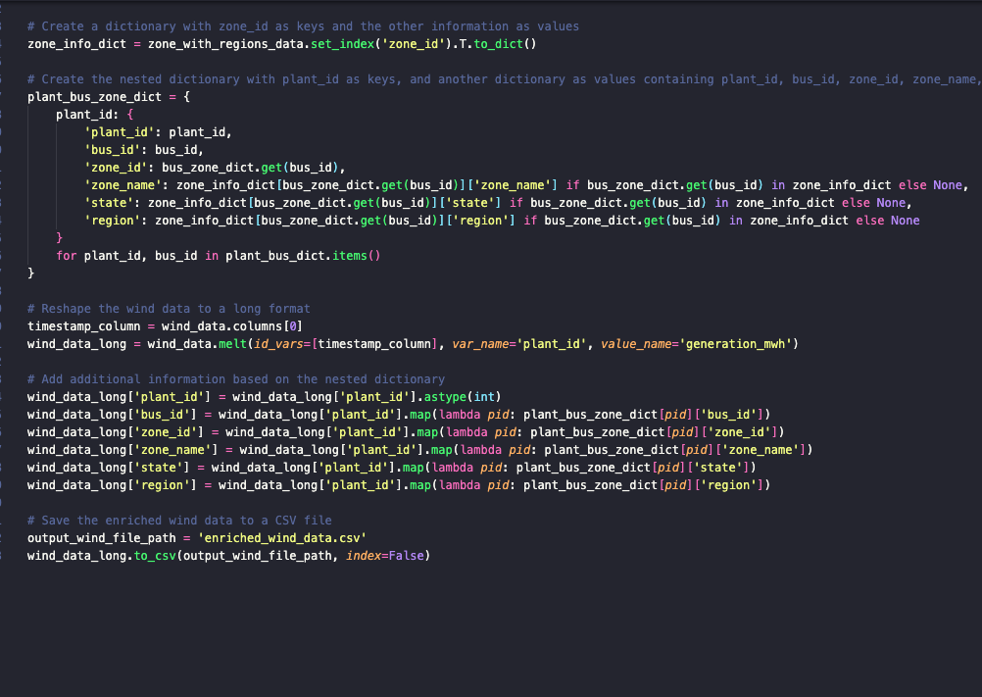
FILE TRANSITION SOLUTION
Read raw power data file that required to re-organize
Same format for hydro, wind, solar
Output to updated csv file with still time-series value but also include detailed information for easy understanding

